Slide 1

2027 USCA SIEGER SHOW BID
PROPOSAL DETAILS
DATE: September 24-26, 2027
VENUE: Willow Haven Park
Kankakee/Momence, Illinois
AIRPORT: Chicago – ORD & MDW
HOTELS: Wyndham Garden, Quality Inn,
Best Western
Predicted Temperatures: High 70’s to low 80’s

Slide 2
MiD Central Illinois Schuthund is a very active, full member USCA Club. notable events hosted by the new leadership:
~ 2019 & 2025 USCA/GSDCA Quali Trial
~ 2023 USCA MidCentral Regional Championship
~ 2024 & 2026 USCA MiDcentral Regional Breed evaluation
Host experience
USCA Club since approximately 2018
~ New leadership of the club bidding this event, since 2021
Multiple club trials & club level breed evaluations.
Motivated to support the USA Show Enthusiasts

Slide 3
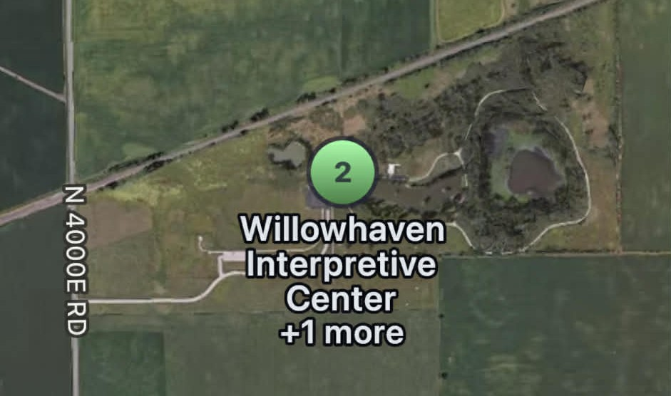
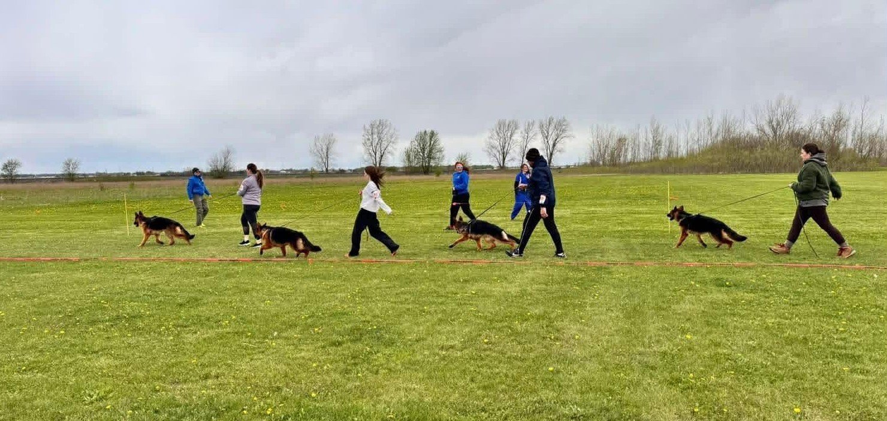
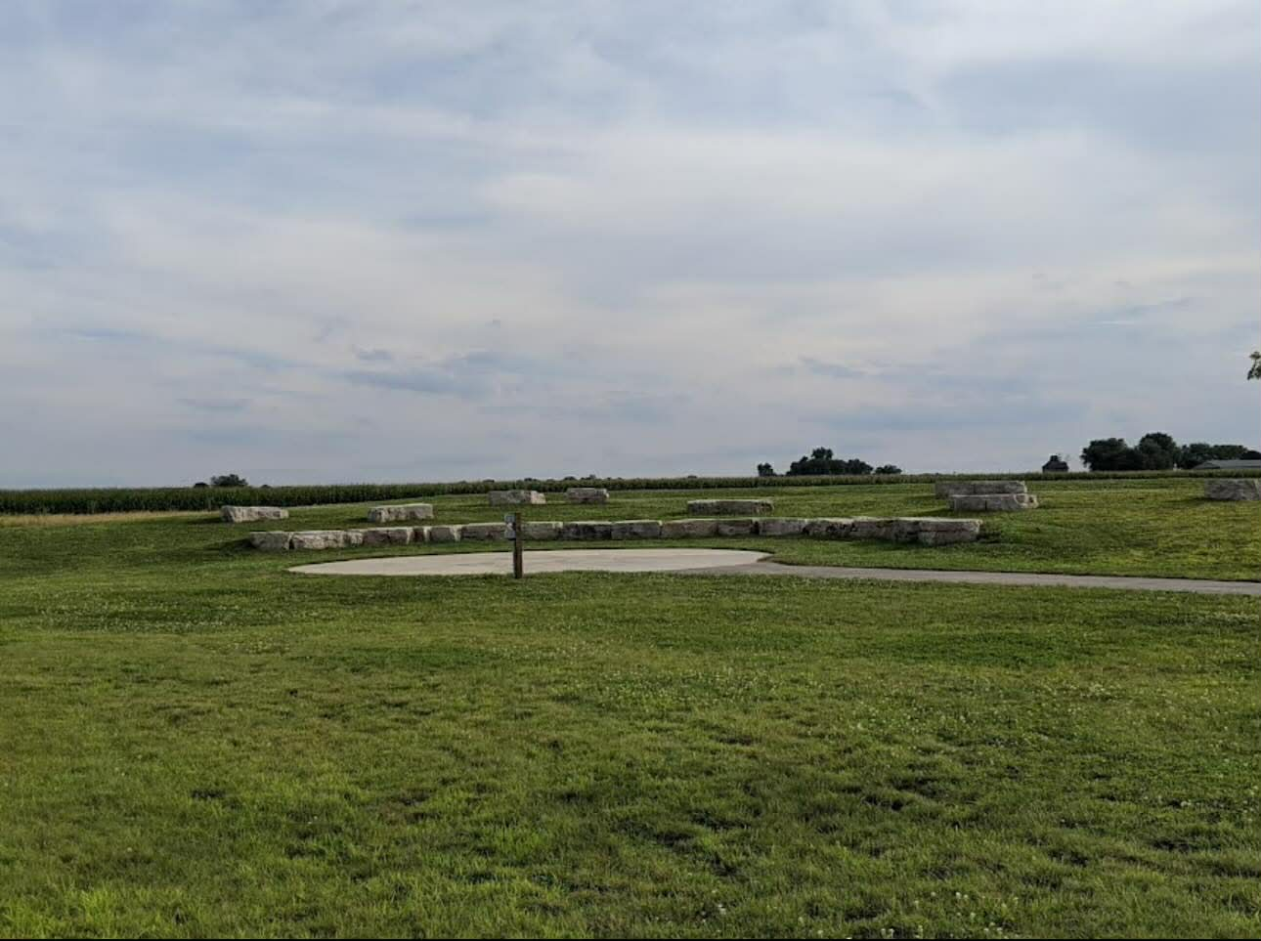
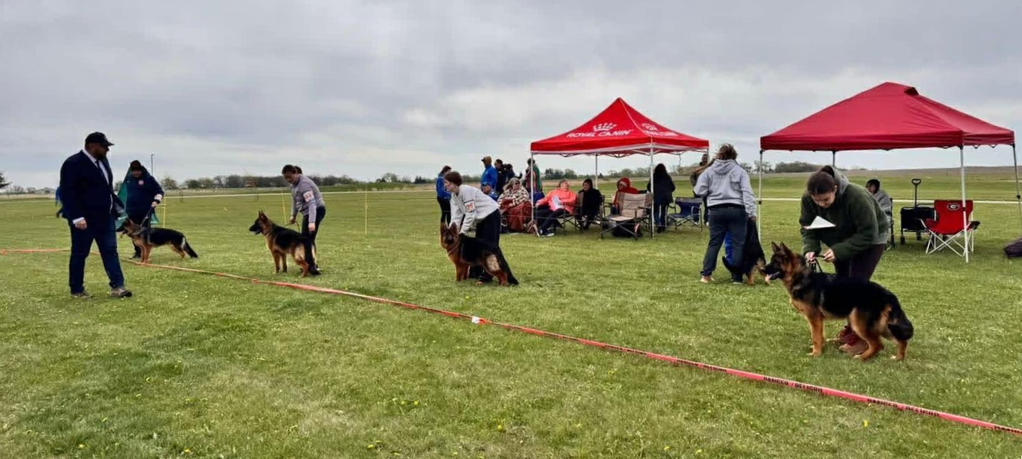
VENUE
WILLOW HAVEN PARK, KANKAKEE/MOMENCE, ILLINOIS

Slide 4
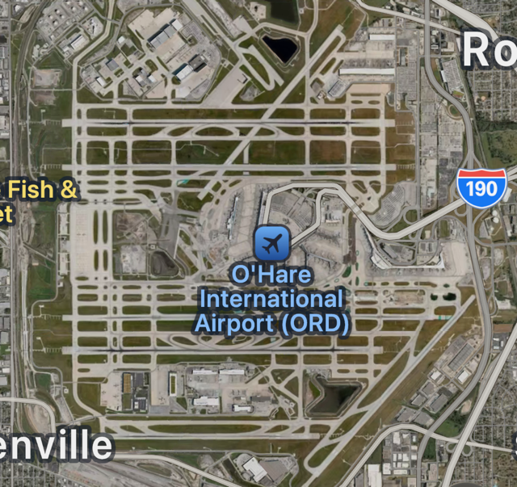
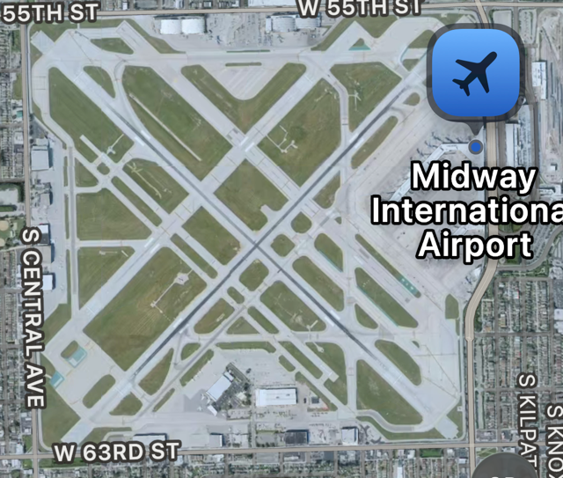
~ Chicago – O’Hare International Airport - ORD
~ Chicago – Midway International Airport - MDW
AIRPORTS
2 CHICAGO AIRPORTS

Slide 5
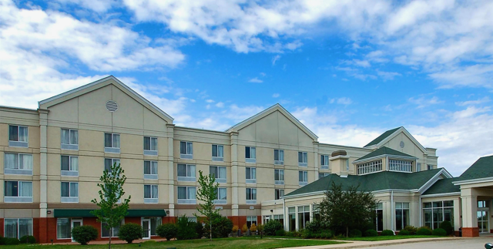

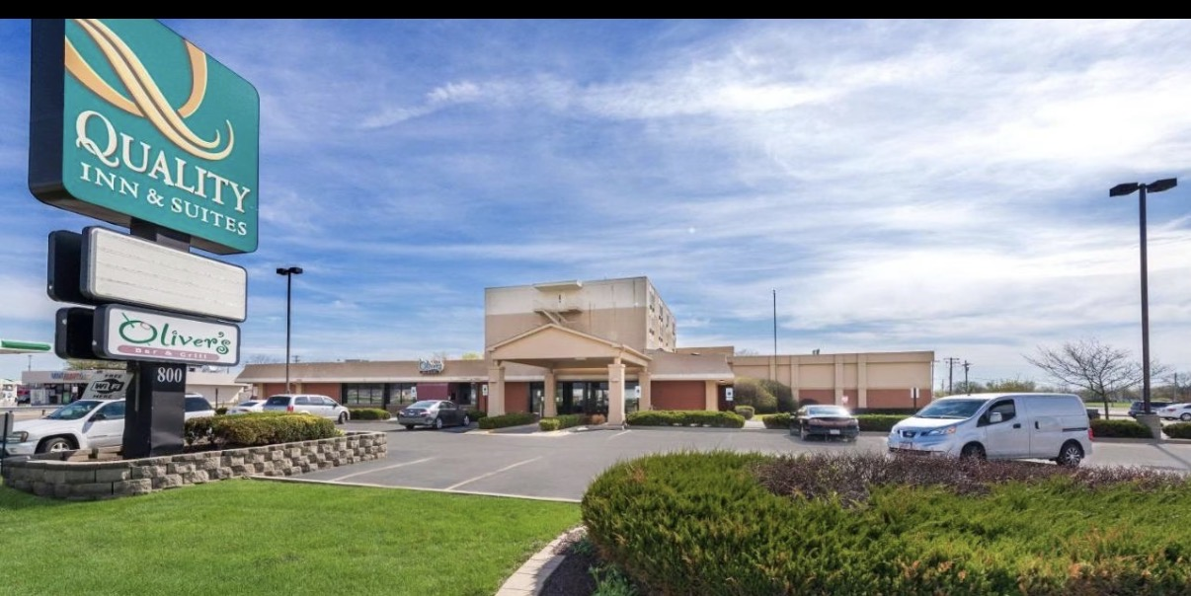
~ Wyndham Garden - Host $99/night
~ BEST Western
~ Quality inn
3 Hotels
PLENTY OF ROOM FOR SIEGER SHOW COMPETITORS

